Slide 1
Digital Inclusion For All
Medici Final Conference
26th - 27th - 28th January 2021

Slide 2
Agenda
First part
Presentation of four practices from the MEDICI Catalogue:
Able to Include
RIX Wiki
ALFIN Senior
PEAK and NeuroNation
Second part
Discussion
People with disabilities
Older people

Slide 3
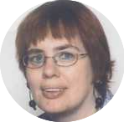
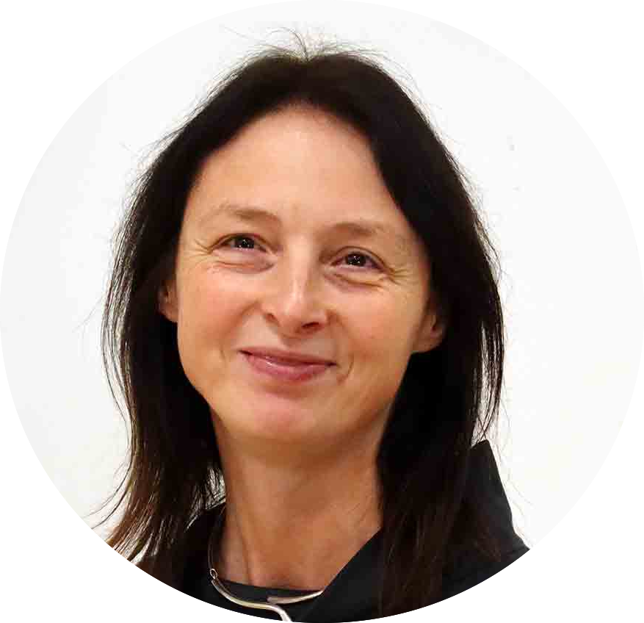
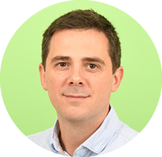
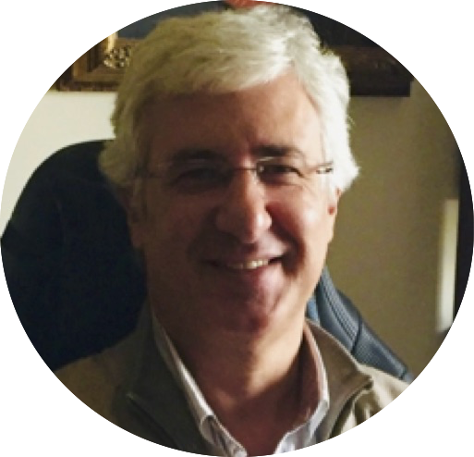
ROUNDTABLE DISCUSSION
27th January 10:30am CET
Ineke Schuurman
Not just words: how older people
and people with disabilities
can become better integrated
in the digital world
Gosia Kwiatkowska
Pedro Beitia
Henrique Gil

Slide 4
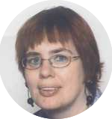
ABLE TO INCLUDE
Ineke Schuurman
Researcher at
Centre for Computational Linguistics
Katholieke Universiteit Leuven, Belgium

Slide 5

ABLE TO INCLUDE
An overview
Ineke Schuurman
KU Leuven

Slide 6
What…
Able to Include seeks to provide people with intellectual and developmental disabilities (IDD) to communicate with their family, friends, colleagues …
Nowadays often using digital means (mails, social media, …)
Social Inclusion via Digital Inclusion
Able to Include
EU-project (CIP PSP) 2014-2017

Slide 7
Who…
KU Leuven, Belgium
The National Microelectronics Applications Centre (MAC), Ireland
Thomas More Kempen, Belgium
Universitat Pompeu Fabra, Spain
Building Bridges Training, United Kingdom
Inclusion Europe, Belgium
Fundación Prodis, Spain

Slide 8
The Users
Very important:
Work in the project done in close collaboration with them!
What are their needs, wishes, … (also talks with family, carers if necessary)
How do they deal with tools available at a certain moment (also observations!)
co-creation

Slide 9
The Users/2
People with Intellectual Disabilities (for example Down syndrome)
In Able to Include this meant users having serious issues with
writing / reading text
understanding text, and also
understanding what can be said/written
Text simplification, spelling correction,
use of pictographs, text2speech …
and (individual) sessions on usage of tools

Slide 10
Tools
Able Social – ability to translate between written language and pictographs, or to speech
Able Chat – use of smartphone to send messages
Able Mail (Kolumba) -- mail manager for Gmail
Making use of spelling correction, simplification, pictographs, text2speech, …

Slide 11
User-driven use of tools
It is up to the user to decide what they are going to use, and how they do it
  When sending: Yes/no pictographs? Which set?
  When receiving? Same choices
  Yes/no spelling correction?
  Yes/no simplification?
  …
Parents and carers can make a pre-selection, for example also wrt the categories of pictographs, or the set to be used, or state that simplification needs to be done …

Slide 12
A real issue
Users may need to have some supervision, esp when they are using social media in an unprotected environment as they often don’t realize what the effects are of what they are saying (granny always puts her keys under the mat).
And what about smart phones …
Discuss such matters with them, and … keep an eye on what is being done (like one does with younger children)
***
In Belgium many youngsters are using a special safe website (wai-not) to connect with their friends.

Slide 13
Thank you for your attention!
ineke.schuurman@ccl.kuleuven.be

Slide 14
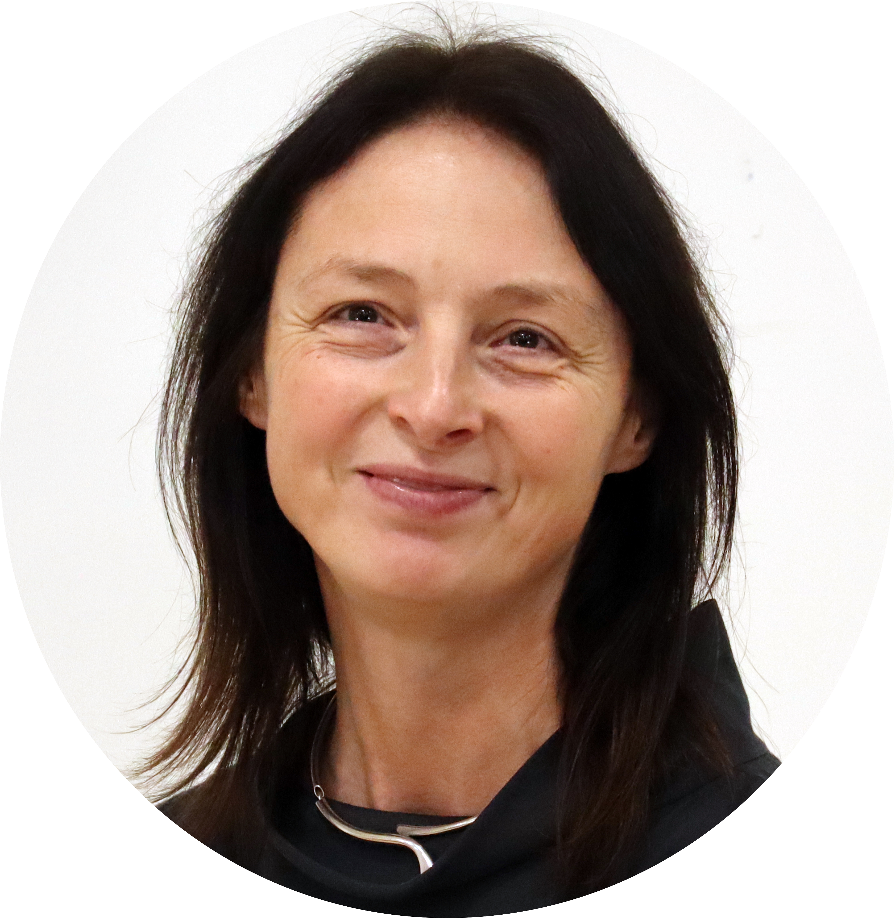
RIX Wiki
Gosia Kwiatkowska
Senior Lecturer & Co-Director at
RIX Research and Media,
University of East London, UK

Slide 15
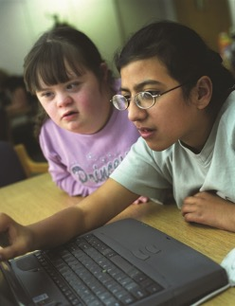
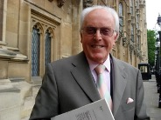
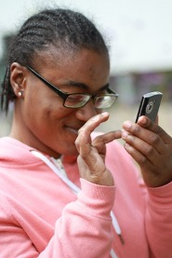
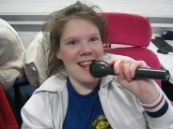

RIX Research and Media – RIX Wiki
Gosia Kwiatkowska, 27 Jan 2021

Slide 16
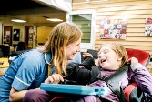
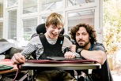
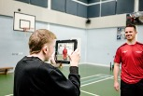
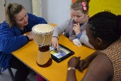
RIX ‘Living Lab’
Software tools and best practice models
Advice and training for implementation
Teaching and Learning at all levels

Slide 17
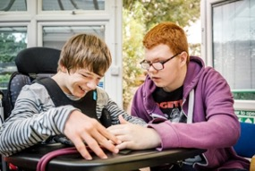
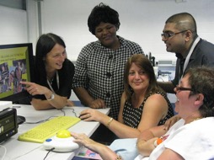
Multimedia Advocacy
Reinforce memories
Organise thinking
Communicate viewpoints
Person-centred principles
Self-Advocacy
Multimedia

Slide 18
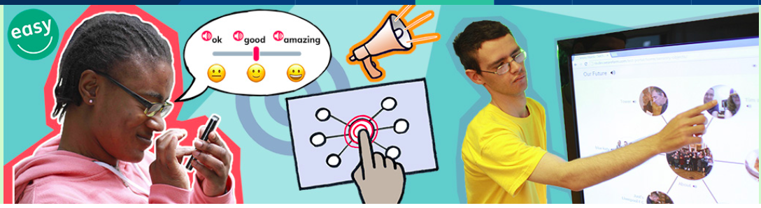
RIX Wiki
RIX Easy Survey
RIX MultiMe Toolkit
Software

Slide 19
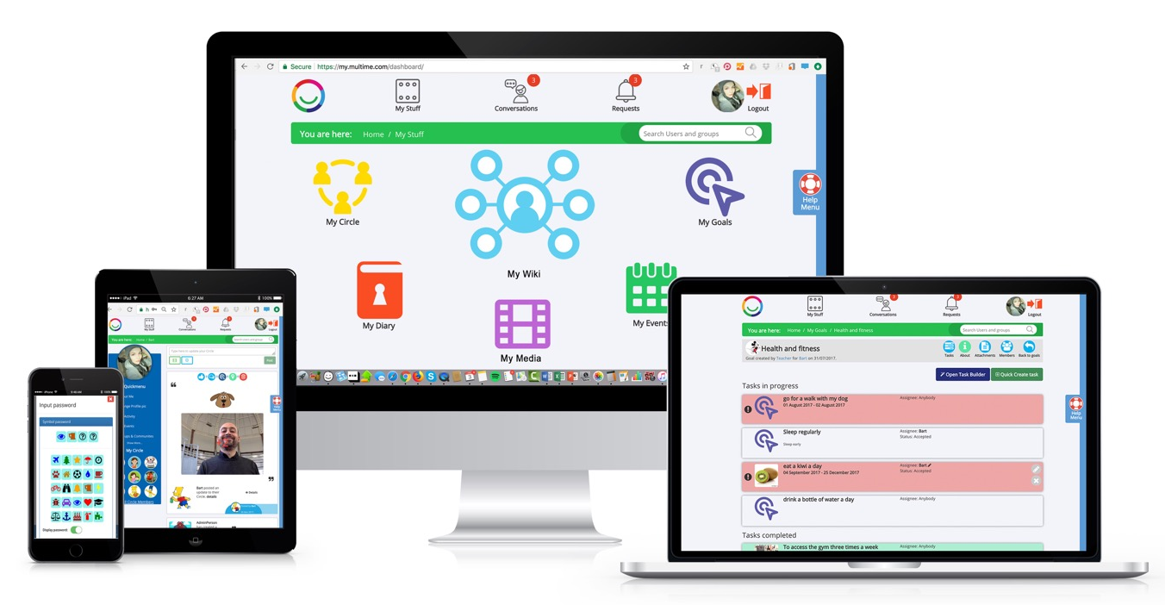
RIX MultiMe Toolkit

Slide 20
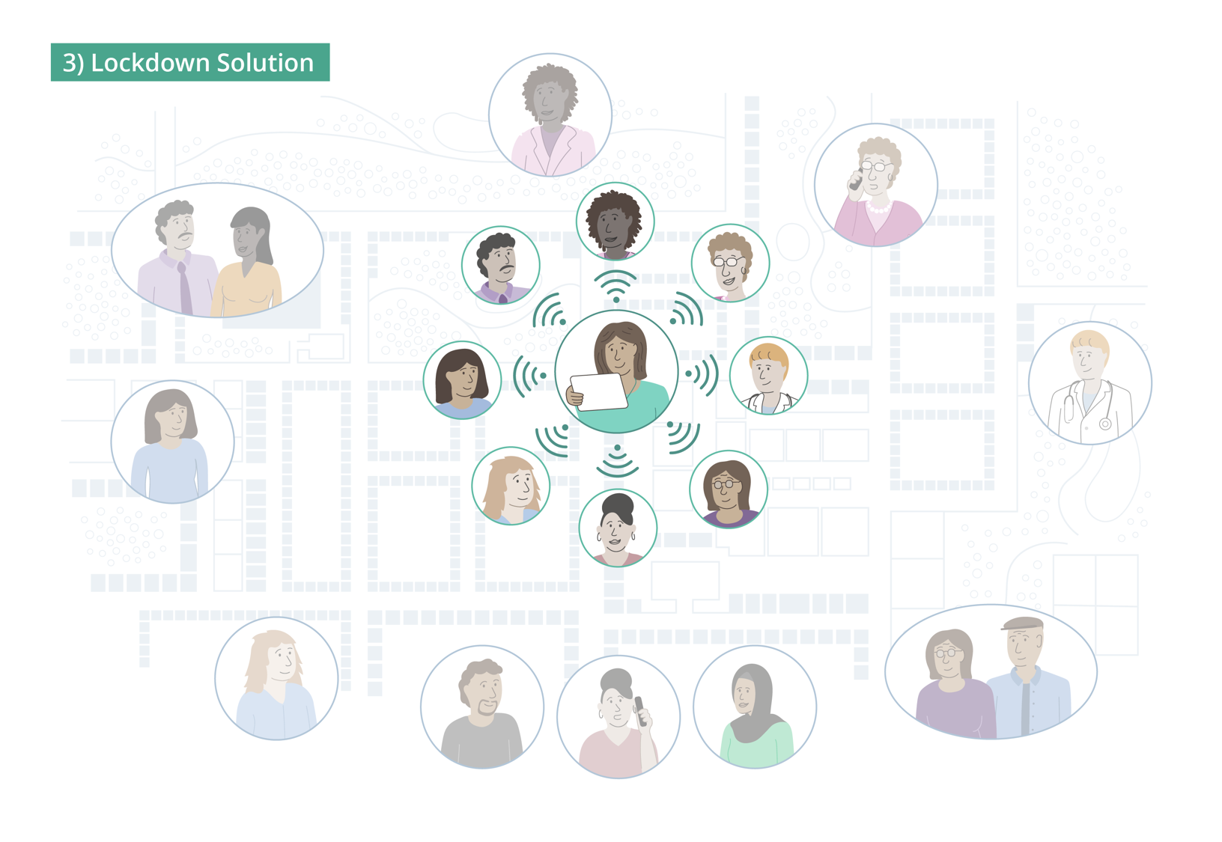
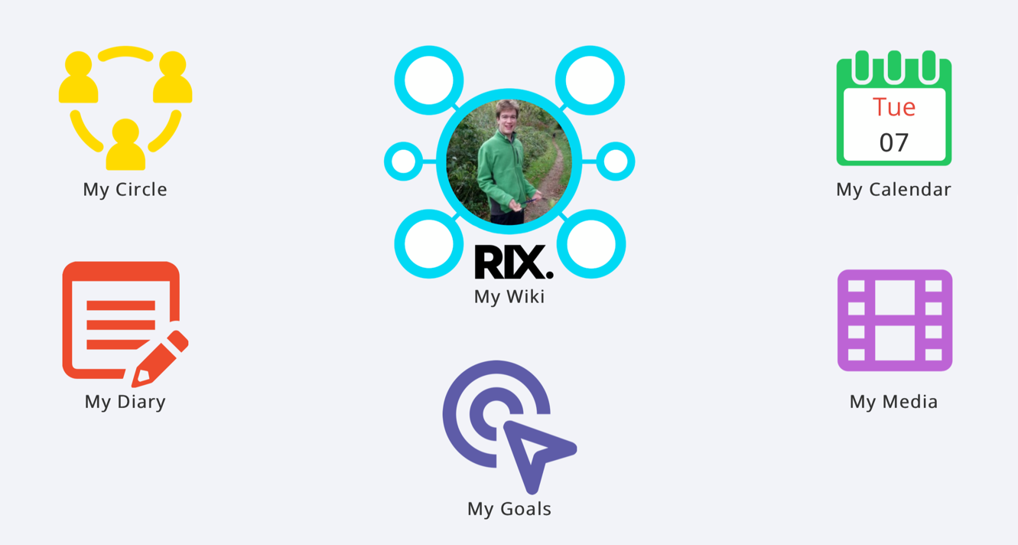

Slide 21
Thank you
RIX Research and Media https://rixresearchandmedia.org
Gosia Kwiatkowska Gosia@uel.ac.uk
Follow me on Twitter: @KwiatGosia

Slide 22
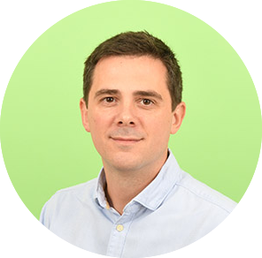
ALFIN Senior
Pedro Beitia
Coordinator at
Fundación EDE, Bilbao, Spain

Slide 23


ALFIN Senior

Slide 24
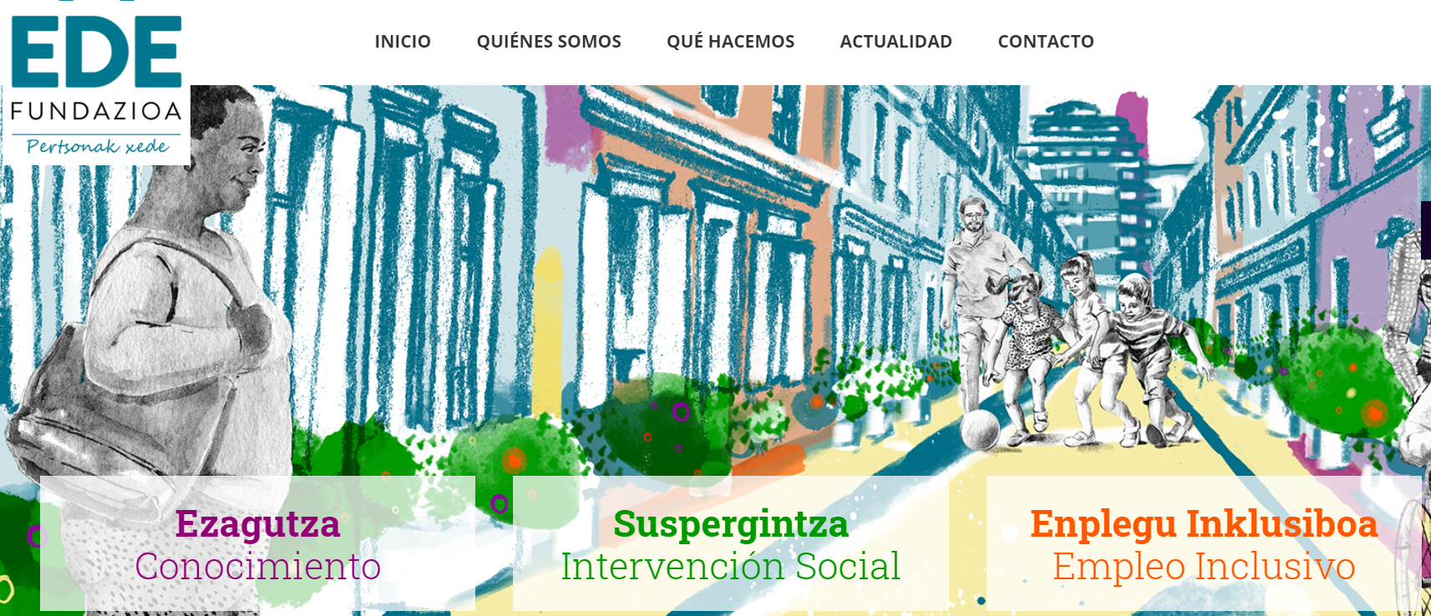
EDE Foundation
What we look for
We look for empowering people and the development of a more just, solidarity and fraternal society.
https://edefundazioa.org/
Ezagutza
Conocimiento
Knowledge
Suspergintza
Intervención Social
Social Intervention
Enplegu Inklusiboa
Empleo Inclusivo
Inclusive Employment
Internazionala
Internacional
International

Slide 25
Alfin Senior
Context
2010-2012
Information and Knowledge Society
Social exclusion – digital divide
References

Slide 26
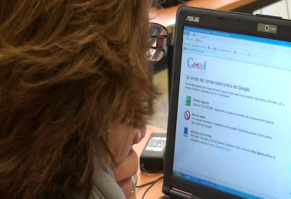
Digital and information literacy
Information literacy deals with the skills related to the use and mastery of information in any of its forms and the technology used to access that information.
Digital literacy means one can use technology to its fullest effect – efficiently, effectively and ethically – to meet information needs in personal, civic and professional lives.
It includes not only the search and analysis of information, but also the reflective and intentional use of it. It is directly related to the promotion of individual autonomy and the development of critical capacity.

Slide 27
Alfin Senior objectives
Effective inclusion in the information society as a full member.
Fostering their critical capacity and personal autonomy.
Encouraging their participation in society.
The recognition of new technologies as a necessary and affordable resource for this group.
Their active ageing and the enhancement of their quality of life.

Slide 28
Objectives
Learn to determinate the extent of information needed.
Use the necessary process and techniques to access information effectively.
Evaluate information and its sources critically and incorporate the selected information into his or her own knowledge base.
Use information effectively to fulfil a specific purpose.
Understand many of the legal and ethic issues surrounding the use of information.
Older people in situation of info-exclusion acquire the necessary skills and abilities to access, use and communicate information in a reflective, critical and intentional way.

Slide 29
Competence-based training
Digital Competences
Recognise the impact of ICTs on society
Use information technology effectively and efficiently
Information literacy Competences
3. Learning to learn
4. Search and access information effectively and efficiently
5. Work in a team
6. Share information
7. Use information ethically and legally

Slide 30
Some conclusions of Alfin Senior programme
The application of an information literacy methodology adapted to the needs, interests and capacities of senior citizens.
The application of methodologies experienced in the framework of the formal education system to groups normally outside of it.
A training programme that seeks to include dimensions of active ageing and lifelong learning.
The use of a competence-based training model designed for elderly people in which not only knowledge, but also skills and attitudes are transferred in a practical way.
The application of an innovative concept such as information literacy in the field of social intervention.

Slide 31
Thank you!

Slide 32
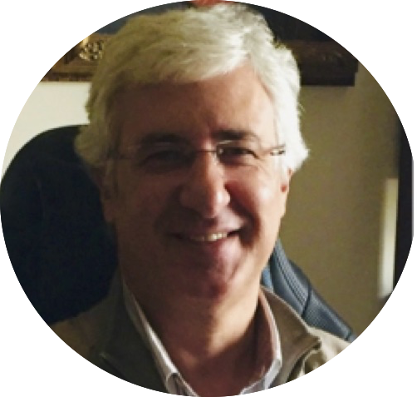
PEAK & NeuroNation
Henrique Gil
Senior Teacher at
Polytechnic Institute of Castelo Branco, PT

Slide 33
The use of PEAK and NeuroNation
digital applications
for the inclusion of older adults
https://www.youtube.com/watch?v=_3ybEKzQHFI&feature=youtu.be

Slide 34
Discussion
and
Q&A session

Slide 35

Upcoming Sessions
ROUNDTABLE DISCUSSION
27th January 02:00pm CET
Leaving no one behind - Vulnerable groups and their complex needs
Register here: https://www.eventbrite.co.uk/e/digital-inclusion-for-all-challenges-possibilities-practitioners-view-registration-131216583333
WEBINAR
28th January 10:00am CET
Covid-19 - Identified Practices dealing with the pandemic
Register here: https://www.eventbrite.co.uk/e/digital-inclusion-for-all-covid-19-practices-dealing-with-the-pandemic-registration-131221146983

Slide 36
Thank you!
www.facebook.com/medici.eu/
www.linkedin.com/company/medici-eu/
www.twitter.com/medici_eu
Search us on youtube.com

